Slide 1
DC.p4: Programming the forwarding plane of a datacenter switch
Anirudh Sivaraman*, Changhoon Kim†,
Ramkumar Krishnamoorthy†, Advait Dixit†, Mihai Budiu†
* Massachusetts Institute of Technology
† Barefoot Networks

Slide 2
The case for programmable forwarding planes
Programmable switch architectures: RMT, FlexPipe, XPliant
Languages for packet processing: P4, POF, packetC, PX
Open interfaces: OpenFlow, SAI

Slide 3
This talk: Programming a large forwarding plane in P4
Successfully programmed a datacenter forwarding plane in P4
Language features contributed to P4 specification
Lessons learned in the process
Notes:
Chang: P4 position paper about a year ago with several high-level abstractions but the details weren’t clear.
This talk is about the delta between the current P4 spec and the original paper at a high level of abstraction.
What are the deltas and why?
Jonathan question: How do you design a language for a switch?
Hari: Make two points:
We implemented a commodity datacenter switch in P4. (I ‘ll tell you about how that’s done.)
What we learned from doing that. (This is what we learned.)
We tried to implement → we got there → we reflect on what we learned.
Jonathan: P4 is a high-level language only relative to assemblu and Verilog, not Java.

Slide 4
The P4 programming language in one slide
Abstract switch model: Ingress → Buffer → Egress
Headers: User-defined formats (TCP, IP, arbitrary)
Parsers: Parse graph (Ethernet, then IP, then TCP)
Actions:
Primitives: Arithmetic, Read, and Write on fields
Compound actions composed out of primitive actions
Tables: Type (exact v. ternary v. LPM), configurable sizes
Control Flow: Order of table application

Slide 5
P4 in one slide
Parser
Header
Fields
Ingress Stages
Queues
Egress Stages
Match Action
Match Action
Match Action
Match Action
Eth
Match Action
Match Action
Match Action
Match Action
IPv4
IPv6
TCP
Match Action
Match Action
Match Action
Match Action
Match: On Arbitrary Header fields
Actions:
Primitives: Arithmetic ops on fields
Read/Write fields
Add/remove fields
Combine primitives into larger actions
Notes:
Amy: Arithmetic ops or other ops name of instructions
Jonathan: DPDK.org has match-action abstractions as well. RTE_pipeline

Slide 6
The P4 development environment
Compiler: compiles P4 to a software switch target
Also generates control-plane API to the switch
Switch plugs into Mininet through virtual interfaces

Slide 7
DC.p4: A datacenter switch in P4
Feature set comparable to shared-memory switches
VLANs, ACLs, Tunnels, ECMP, Link Aggregation, L2/L3 forwarding
Program available at http://git.io/sosr15-p4
Shows how features map to code
Substantial P4 program
2500 lines of P4
25 ingress and 12 egress tables

Slide 8
Features that were easy to express
L2/L3 forwarding
Packet validation
Most actions can be composed from existing primitives

Slide 9
Features that drove language changes
ECMP:
Dynamically select action from a set of actions
ACLs:
Packet cloning primitive
Notes:
Seemed pretty abstract to Amy.
Don’t mention leaf-spine in ECMP here.

Slide 10
Features not yet expressible in P4
Packet scheduling
Rate limiting
Buffer Management

Slide 11
Lessons learned
P4 has the right level of abstraction
No bit offset manipulation
Rides on OpenFlow’s success with match-action tables
What can be improved
Modularity
Removing undefined behavior
Adding new primitives may be unsustainable

Slide 12
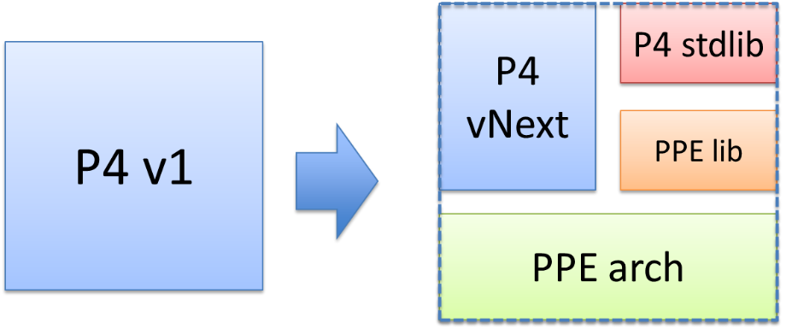
A proposal to evolve P4:
P4 should target other Packet-Processing Engines (PPEs)
Move switch model out of language

Slide 13
Summary
Expressed a datacenter forwarding plane in P4
Lessons learned in the process
P4 program described in the paper: http://git.io/sosr15-p4
Notes:
Hari’s questions and my questions:
Multicast.
Why not clone to CPU and then cull out the digest there?
Clone to CPU: what happens to the original packet?
Clone vs. redirect to CPU?
Where else is digest generation used?

Slide 14
In summary
P4 program described in the paper: http://git.io/sosr15-p4
Empirical analysis of other P4 programs?
Empirical analysis to guide hardware design?
Notes:
Hari’s questions and my questions:
Multicast.
Why not clone to CPU and then cull out the digest there?
Clone to CPU: what happens to the original packet?
Clone vs. redirect to CPU?
Where else is digest generation used? I thought snapshots.

